Slide 1


Slide 2



Daniel Thomas
Biological Safety Officer &
Biosafety Program Leader
Emily Deem
Laboratory Safety Compliance Manager

Slide 3
Upcoming Changes to Federal Life Sciences Policies
Oct 2, 2026

Slide 4
Federal Policy Changes
Two unrelated policy changes are expected within the next year.
U.S. Policy for Stopping High-Risk Research
Draft NIH Biosafety Policy for Research Involving Biohazards

Slide 5
United States Government Policy for Stopping High Risk Life Sciences Research (Stopping Policy)

Slide 6
Stopping Policy
Jul 2026 federal policy that bans Dangerous Gain of Function research and implements screening measures for institutions who receive federal life sciences funding. The stated goal of the policy is to ensure that research which creates more risk than benefit to society is not funded, and that potentially high risk research is evaluated and carried out responsibly.

Slide 7
DURC
Two policies were originally released to address Dual Use Research of Concern.
  USG Policy for Oversight of Life Sciences DURC (March 2012)
  USG Policy for Institutional Oversight of Life Sciences DURC (issued 2014; effective 2015)
Dual Use Research of Concern- Life sciences research that, based on current understanding, can be reasonably anticipated to provide knowledge, information, products, or technologies that could be directly misapplied to pose a significant threat with broad potential consequences to public health and safety, agricultural crops and other plants, animals, the environment, materiel, or national security.

Slide 8
DURC
Scope of policy – 15 agents and toxins and 7 experimental effects
  Agents:
    Highly Pathogenic Avian Influenza
    Bacillus anthracis
    Botulinum neurotoxin
    Burkholderia mallei
    Burkholderia pseudomallei
    Ebola virus
    Foot-and-mouth disease virus
    Francisella tularensis
    Marburg virus
    Reconstructed 1918 Influenza virus
    Rinderpest virus
    Toxin-producing strains of Clostridium botulinum
    Variola major virus
    Variola minor virus
    Yersinia pestis

Slide 9
DURC
Experimental effects:
  Enhances harmful consequences of agent or toxin
  Disrupts immunity or the effectiveness of an immunization against the agent or toxin without clinical and/or agricultural justification
  Confers to the agent or toxin resistance to clinically and/or agriculturally useful prophylactic or therapeutic interventions against the agent or toxin that facilitates their ability to evade detection methodologies
  Increases the stability, transmissibility, or the ability to disseminate the agent or toxin
  Alters the host range or tropism of the agent or toxin
  Enhances susceptibility of a host population to the agent or toxin
  Generates or reconstitutes an eradicated or extinct agent or toxin

Slide 10
P3CO
In January of 2017, recommended policy guidance was published for Potential Pandemic Pathogen Care and Oversight (P3CO)
  Defined a Potential Pandemic Pathogen as one that is both:
    Likely highly transmissible and likely capable of wide and uncontrollable spread in human populations
    Likely highly virulent and likely to cause significant morbidity and/or mortality in humans
  Recommended review mechanisms for enhanced Potential Pandemic Pathogens – those that have been made more transmissible or virulent. Drew upon recommendations from a National Science Advisory Board for Biosecurity report 'Recommendations for the Evaluation and Oversight of Proposed Gain-of-Function Research (May 2016), which discussed 'Gain-of-Function research' and noted that the term 'Gain-of-Function' has become synonymous with enhanced ability for pathogens to cause disease, in the context of the acquisition of new phenotypes or enhancement of existing phenotypes.

Slide 11
DURC/PEPP
USG Policy for Oversight of Dual Use Research of Concern (DURC) and Pathogens with Enhanced Pandemic Potential (PEPP) [May2024]
  Split research into two categories. Category 1 (DURC) and Category 2 (PEPP).
    Category 1 involved Federally-regulated Select Agents, certain Risk Group 3, and Risk Group 4 agents.
    Category 2 involved Pathogens with Pandemic Potential (PPP) - Pathogens likely capable of wide and uncontrollable spread in human populations and would likely cause severe disease and/or mortality in humans.
  Policy was set to go into effect in May 2025 but was rescinded in a May 2025 Executive Order.

Slide 12
U.S. Policy for Stopping High Risk Life Sciences Research
Broad executive policy from the White House that will apply to all funding agencies.
The policy replaces previous policies for Dual-Use Research of Concern / Pathogens with Enhanced Pandemic Potential.
Defines “Dangerous Gain-of-Function Research” (DGOF) and “International Research of Concern” (IROC). Both are effectively banned, and screening measures are required.

Slide 13
Dangerous Gain-of-Function Research
DGOF – Research that enhances a property or properties of a biological agent in ways that make it more dangerous.
  Research that seeks, achieves, or has a substantial risk of achieving one or more of the below outcomes and could result in significant negative societal consequences:
    Enhancing harmful consequences of a biological agent
    Disrupting immunological response or effectiveness of immunization
    Conferring resistance to clinically or agriculturally useful therapeutic interventions or facilitating its ability to evading detection methodologies
    Increasing stability, transmissibility, or ability of agent to be disseminating
    Altering host range or tropism of an agent
    Enhancing susceptibility of a human, animal, or plant host population to the agent
    Generating or reconstituting an eradicated or extinct biological agent

Slide 14
Dangerous Gain-of-Function Research
Potential DGOF- Research with a biological agent that could potentially result in one or more outcome listed above and could result in significant negative societal consequences.
  Permitted but requires review and recommendation by independent third-party review body (ITPRB) to establish risk mitigation plan and perform risk-benefit analysis.

Slide 15
International Research of Concern (IROC)
•Prohibits international life sciences research involving entities of concern (conducted in a country of concern or by institutions or individuals of concern).
•Permits life sciences research that could reasonably pose a threat to public health, public safety, and economic or national security in countries with inadequate oversight to ensure that the country is compliant with US oversight standards and policies.

Slide 16
Stopping Policy General Requirements
Institutions who receive life sciences funding are to follow policy.
PI must evaluate all life sciences applications and document whether they are Potential DGOF or not. Known DGOF is banned.
An Institutional Contact for Dangerous Gain of Function Research (ICDGOF) must be appointed and must review and certify all life sciences funding applications.
An Institutional Review Entity (IRE) must review all potential DGOF and perform risk-benefit analysis to submit for independent review.

Slide 17
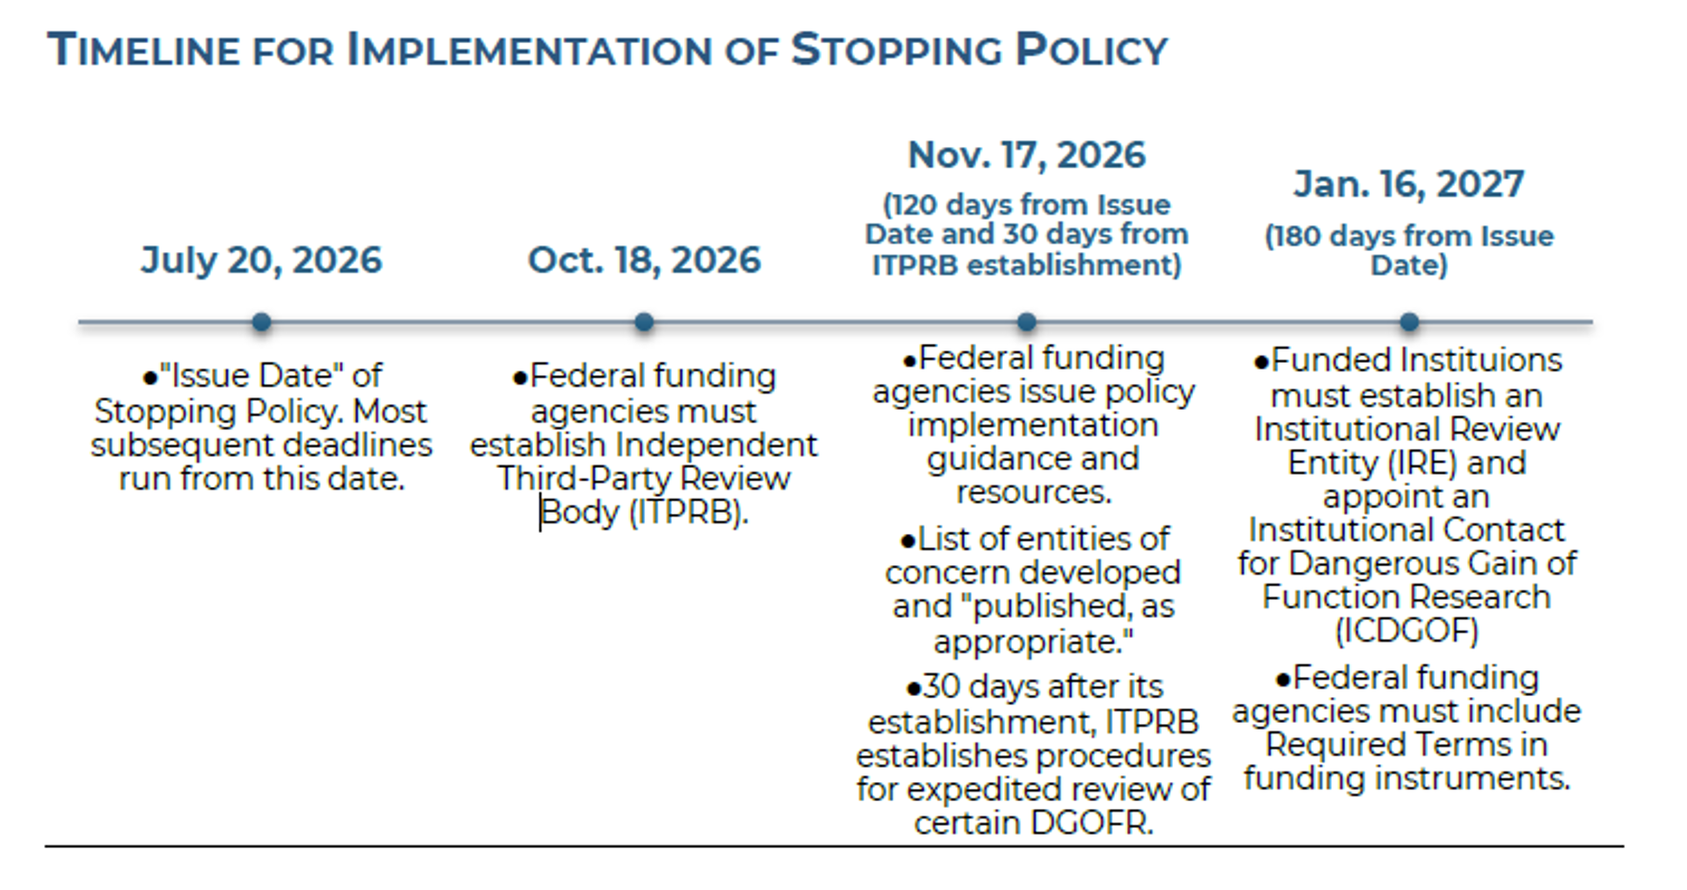

Slide 18
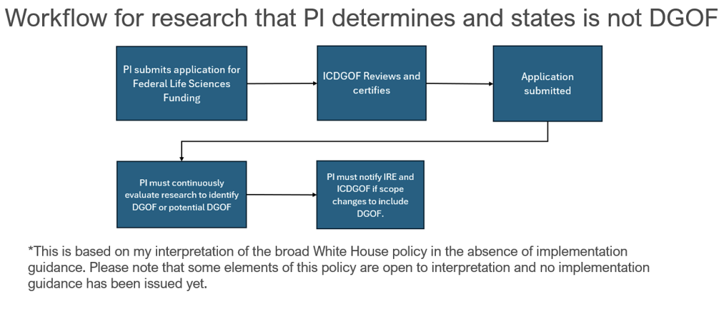

Slide 19
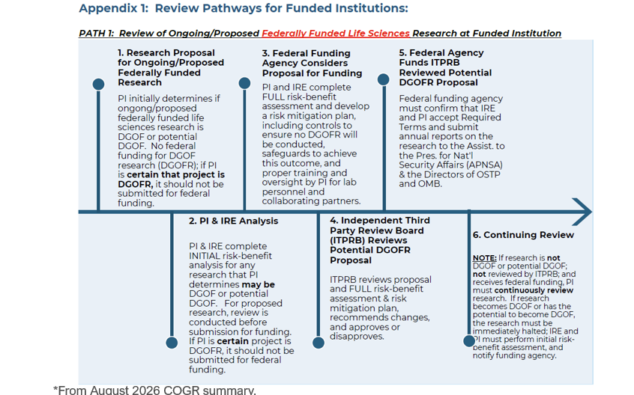

Slide 20
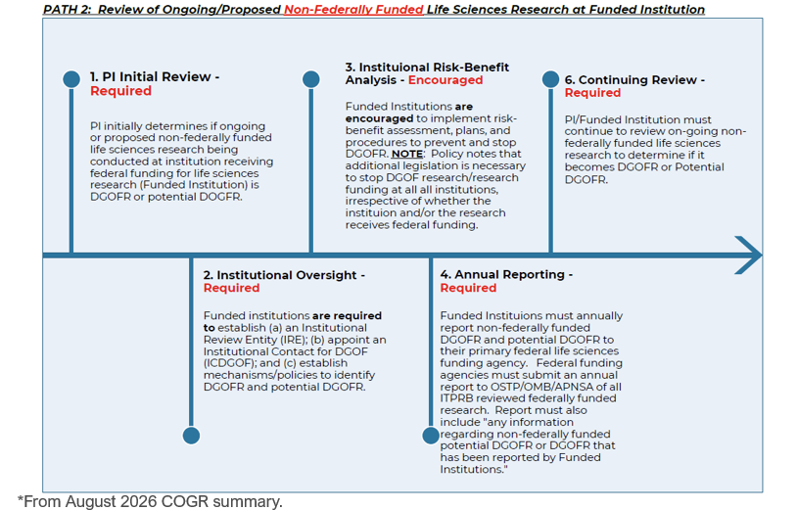

Slide 21
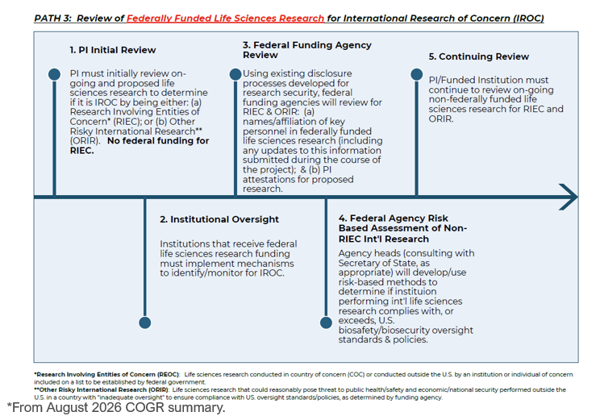

Slide 22
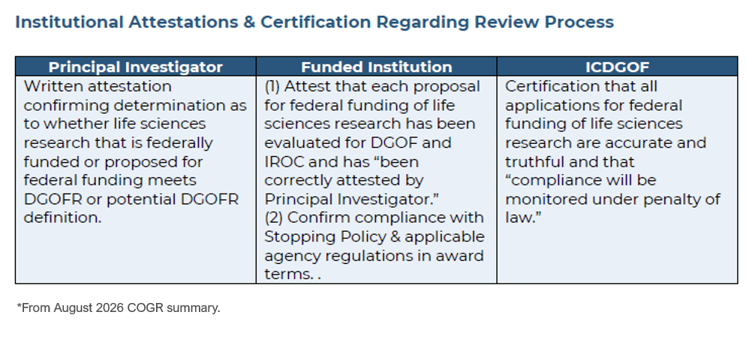

Slide 23
Stopping Policy Penalties
Failure of institutions to follow this policy may result in suspension of institution’s ability to obtain any federal life sciences funding for up to 5 years.
Failure of PI to identify DGOF or Potential DGOF may result in suspension of ability to obtain federal life sciences funding for up to 5 years.
ICDGOF must certify life sciences funding applications under penalty of law, possibly treated as a violation of False Claims Act.

Slide 24
Where do we go from here?
DURC policy was generally overseen by biosafety programs.
Due to the scope of the Stopping Policy, this may be best managed as a cross-disciplinary research integrity issue.
EHS has communicated this policy and our concerns to ORIED and Export Control and are in the process of submitting to Deborah Crawford's office for review.
Please be aware that more guidance on these reviews should be coming up very soon!

Slide 25
Questions?

Slide 26

Draft National Institutes of Health Biosafety Policy for Research Involving Biohazards

Slide 27
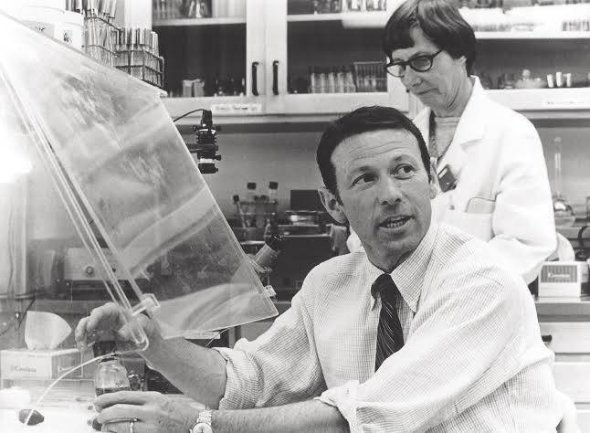
The NIH Guidelines for Research Involving Recombinant and Synthetic Nucleic Acid Research
Late 1960s and Early 1970s
Paul Berg proposes an approach to create recombinant DNA in vitro and use it to manipulate genes across species
Independently, several other approaches and successful experiments involving recombinant DNA occur
Robert Pollack and others raised concerns about potential biohazards with this technology
Paul Berg - biochemist

Slide 28

The NIH Guidelines for Research Involving Recombinant and Synthetic Nucleic Acid Research
First Asilomar Conference – 1973
The main concern discussed at this conference in California was the risk of cancer from genetically modified viruses.
  Remember simian virus 40 (SV40)-contaminated polio vaccines?
Result of this conference: researchers requested that the National Academy of Sciences (NAS) establish a committee to evaluate risks and benefits of rDNA research
Paul Berg (Chair) and committee members produced a statement requesting that the scientific community honor a voluntary moratorium on certain types of experiments
Asilomar Conference Center

Slide 29

The NIH Guidelines for Research Involving Recombinant and Synthetic Nucleic Acid Research
Second Asilomar Conference - 1975
The moratorium was universally observed
This time, the conference was made international
  140 attendees that included scientists (some from other countries), lawyers, members of the press, ethicists, and government officials
Agreed that recombinant DNA experiments should continue, but guardrails should be made
  Assign risk estimates to different experiments and apply physical and biological containment
These recommendations led to the first NIH Guidelines, published June 23, 1976
The NIH Guidelines mandate the establishment of an Institutional Biosafety Committee (IBC)

Slide 30




What is an IBC?
The University of Tennessee, Knoxville (UTK) Institutional Biosafety Committee (IBC) oversees the use of biological hazards used in research, teaching, diagnostic testing and other activities conducted at, sponsored by, or on behalf of the Knoxville-area campuses: UTK, Institute of Agriculture (UTIA), College of Veterinary Medicine (CVM), and UTHSC College of Medicine-Knoxville (UTHSC COM-Knoxville).
The IBC is committed to protecting faculty, staff, students, visitors, the general public and the environment from exposures (or potential exposures) to biological hazards.

Slide 31
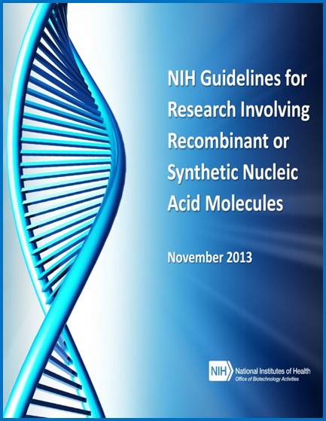
The NIH Guidelines for Research Involving Recombinant and Synthetic Nucleic Acid Research
For 50 years, the NIH Guidelines have specified the biosafety practices and containment principles for constructing and handling rsNA.
Periodic updates have attempted to keep up with the rapidly changing technologies, including the most recent update in 2024 to address GDMOs.
But is it enough?

Slide 32
NIH Launches Initiative to Modernize and Strengthen Biosafety Oversight
NIH Director, Dr. Jay Bhattacharya published a statement on September 9, 2025.
This statement announced the NIH’s intention to overhaul the current guidelines and expand the framework beyond recombinant and synthetic nucleic acids.
Public listening sessions were held, comments were collected, and on August 19, 2026, the Draft NIH Biosafety Policy for Research Involving Biohazards was published.

Slide 33
Draft NIH Biosafety Policy
The policy applies to all INSTITUTIONS conducting NIH-supported research.
Policy covers research with biological hazards that poses a risk to human health and involves any of the following:
  Wild-type biological agents that cause disease in humans
  Cells, viruses, or organisms (other than plants) that have been genetically modified
  Toxins, prions, and other self-aggregating proteins
  Cells or organisms (other than plants) containing any of the above

Slide 34
Draft NIH Biosafety Policy
Section III-B: Responsibilities of the Institutional Biosafety Committee (IBC)
Reviewing research for compliance with the Policy, including a risk assessment of the biocontainment level, facilities, procedures, practices, training, and expertise of personnel involved in the research.
Performing periodic reviews of approved research.
Reporting certain incidents to the NIH that pose a significant risk to human health.
Taking minutes of IBC convened meetings and posting them no later than the next convened meeting.

Slide 35
Draft NIH Biosafety Policy
Section III-C: Responsibilities of the Principal Investigator (PI)
Ensuring no research within the scope of the Policy is conducted without full approval.
Reporting any incidents during conduct of research.
Ensuring all lab personnel are trained.
Performing an initial risk assessment and proposing risk mitigation strategies.
Submitting the initial research protocol and any subsequent changes for review and approval.
Informing the lab personnel of the reasons and provisions for any occupational health or exposure response procedures.

Slide 36
Draft NIH Biosafety Policy Review Categories
Section IV-1 Research that Requires NIH and IBC Approval Before Initiation
Research involving emerging, novel, or zoonotic agents for which the Risk Group classification or a recommendation for minimum level of containment is not available in Biosafety in Microbiological and Biomedical Laboratories.
Initial requests for NIH to lower containment for research involving RG3 or RG4 (WT or recombinant) agents
Initial requests for NIH to lower containment below BSL-2 for research involving gene drive modified organisms

Slide 37
Draft NIH Biosafety Policy Review Categories
Section IV-2 Research that requires IBC review and approval before initiation
Research involving RG3 or RG4 agents (WT or recombinant)
Research involving genetically modified cells, viruses, or organisms other than plants
Research involving Select Toxins, prions, or other self-aggregating proteins
Research with primary cells that may be contaminated with adventitious agents
Research with wild type or genetically modified RG2 agents for which lower containment is requested, or recombinant RG3 or RG4 agents previously approved by NIH for lower containment
Clinical research viral vector, RG2, or those that require higher risk manipulations

Slide 38
Draft NIH Biosafety Policy Review Categories
Section IV-3 Research that requires review and approval before initiation but that may be delegated to an individual or subgroup of IBC members
Minor amendments to previously approved IBC submissions
Research involving WT RG2 agents
Research involving genetically modified RG1 agents
Research conducted with transgenic organisms at BSL1/ABSL1
Research with plasmids or replication incompetent, non-integrating viral vectors expressing low risk transgenes
Research with well-characterized cell lines
Research with biological toxin proteins not on the Select Agent list

Slide 39
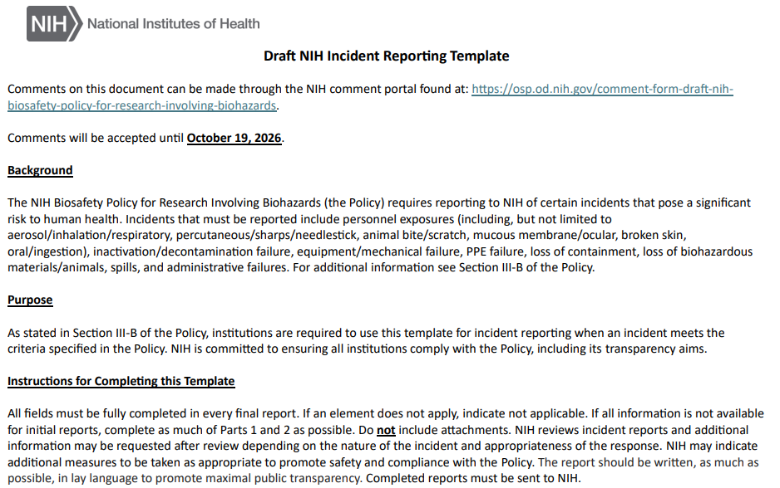
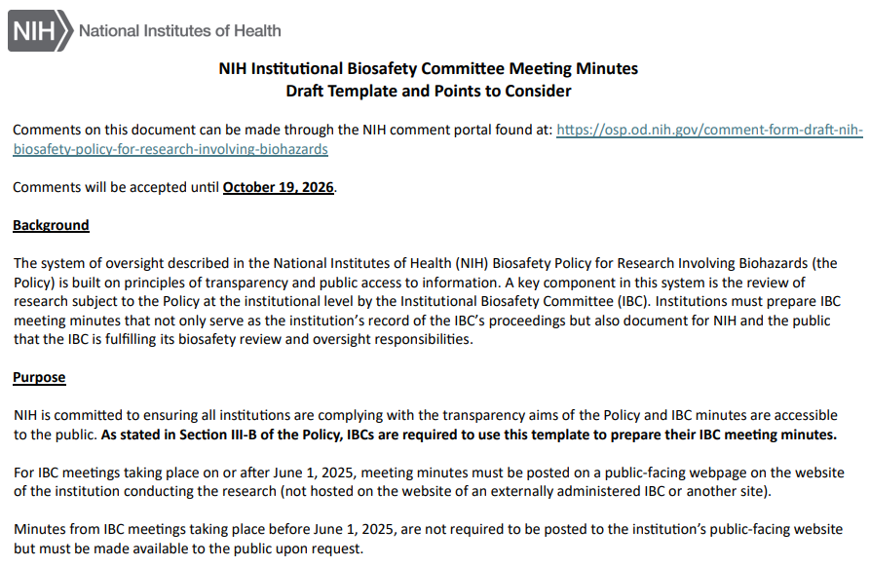
Incident Reporting & Minutes Templates
Currently, the NIH provides templates for incident reporting and for the minutes that are optional to use.
Under the NIH Biosafety Policy, they will no longer be optional.

Slide 40
What’s Different from the NIH Guidelines?
Wild-type infectious agents have been added to the scope.
Self-aggregating proteins have been added to the scope.
Biological toxins are broadly added without the median lethal dose (LD50).
Transgenic plant work removed from the scope.
Currently under the Guidelines, there are exemptions for certain recombinant DNA experiments deemed extremely low-risk. The proposed Biosafety Policy does not have an exemption list.
Under the new Policy, we will be required to publicly post incident reports, along with meeting minutes and the roster of our committee.
  Note: UTK IBC has been publicly posting minutes for years.

Slide 41
Public Comments Accepted By NIH
Public comments are being accepted on the NIH Biosafety Policy (NOT the Stopping Policy) until October 19, 2026.
Comments are being accepted on the Policy, the Incident Reporting Template, and the Minutes Template.
https://osp.od.nih.gov/comment-form-draft-nih-biosafety-policy-for-research-involving-biohazards/

Slide 42
Public Comments Accepted By NIH
https://osp.od.nih.gov/comment-form-draft-nih-biosafety-policy-for-research-involving-biohazards/
The comment form specifically asks for feedback on:
  Appropriateness of the scope of the new policy
  Continued utility of Risk Groups for baseline risk assessment
  Implementation resources

Slide 43
UTK Institutional Biosafety Committee
We have always had a scope that expanded beyond the initial charge of registering recombinant and synthetic nucleic acids
  Including human and non-human primate derived materials, infectious agents, venomous/poisonous animals, nanoparticles…
We have a strong committee membership with a wide range of expertise.
122 registrations – 110 Principal Investigators – 29 Departments/Units

Slide 44
Next Steps
The final, official Biosafety Policy is predicted to be released this Winter, with an implementation deadline of Summer 2027.
  Guidance on implementation is expected from the NIH.
Principal Investigators will be informed of any changes to IBC operations and purview.
Please be patient as we update our Charter & Bylaws, Standard Operating Procedures, and training!

Slide 45
Questions?

